Slide 1
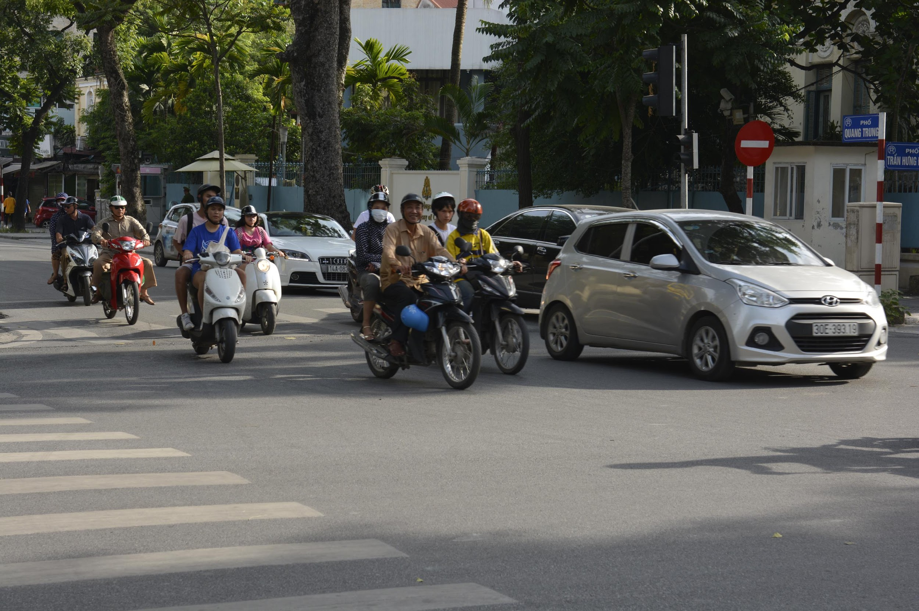
Mobilization Project Planning (Exercises)
Image: Sharon Grant
Biodiversity Data Mobilization Course
Notes:
WHOLE GROUP TOGETHER [TRAINER]
This session is part of the planning section.

Slide 2
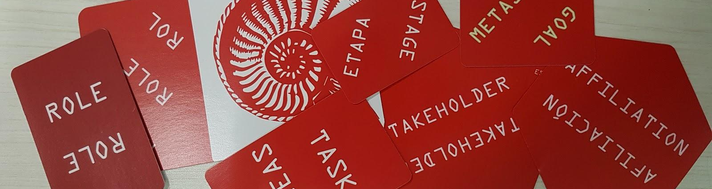
PLANNING FOR MOBILIZATION - EXERCISES
“To the end of his days Bilbo could never remember how he found himself outside, without a hat, walking-stick, or say money, or anything that he usually took when he went out; leaving his second breakfast half-finished and quite unwashed-up,” Tolkien, J.R.R. (1937) The hobbit, or, There and Back Again. George Allen & Unwin Ltd. London.”
Tolkien, J.R.R. (1937) The hobbit, or, There and Back Again. George Allen & Unwin Ltd. London.
Notes:
WHOLE GROUP TOGETHER [TRAINER]
This is group exercise.
The aim of these exercises is to give you a practical tool that you can use to decipher the relationships between the groups of people that will be involved with, and have an affect on, your project (either directly or indirectly).
You should already have read Use Case 1 and watched the videos on RESOURCING and ORGANIZING Have it handy with you during the exercises as you will need to refer back to it.
Table assignments:
RED: https://playingcards.io/vbtkgd
GREEN: https://playingcards.io/m53by6
YELLOW: https://playingcards.io/kpen5h
BLUE: https://playingcards.io/8dwg98
PURPLE: https://playingcards.io/fah8an
Use Case 1: https://docs.gbif.org/course-data-mobilization/en/scenario.html
Use Case 1 Suggested Solution: https://docs.gbif.org/course-data-mobilization/course-docs/UC1-Herbarium-Suggested-Solution_EN.pdf

Slide 3

REVIEW - RESOURCING
Good planning begins by defining the elements that will have an impact on your project and understanding the interactions between them.
Task Cards
Things that must be done in order, to successfully carry out the project.
Goal Cards
Achievements and deadlines that have be committed to in the proposal.
Affiliation, Stakeholder and Role Cards
People and the structures in which they exist and must work.
Notes:
WHOLE GROUP TOGETHER [Led by TRAINER]
As a quick review of the RESOURCING session:
In the Resourcing session:
-- We have looked at the classifications of individuals and groups of people; and the ways in which they interact which each other that may support or block progress in the completion of your project.
-- We then briefly discussed the need to identify the practical tasks that will need to be accomplished.
-- Lastly, but arguably most importantly, we emphasized that a workable implementation plan begins with a thorough review of the goals and deadlines of the project.

Slide 4
EXERCISES
GOALS to TASKS
STAKEHOLDERS to AFFILIATIONS
ROLES to STAKEHOLDERS
TASKS to ROLES
TASKS to STAGES
A
B
Notes:
WHOLE GROUP [TRAINER]
There are three steps to complete in within exercises A and two steps to complete within exercise B :
The following time will be allotted for each step.
**********
1) GOALS to TASKS
Selecting GOALS and identifying the TASKS required to complete them
(10 minutes in breakout, 10 minutes in full group)
**********
2) STAKEHOLDERS to AFFILIATIONS
and identifying the STAKEHOLDER AFFILIATIONS
3) ROLES to STAKEHOLDERS
Assigning ROLES to their STAKEHOLDER groups
(25 minutes to complete steps 2-3 in breakout, so divide the time; 10 minutes in full group)
**********
4) TASKS to ROLES
Deciding which ROLES will carry out which TASKS
(15 minutes in breakout; 10 minutes in full group)
**********
5) TASKS STAGES
Deciding what order things should happen in
(20 minutes in breakout; 10 minutes in full group)

Slide 5
EXERCISES
GOALS to TASKS
STAKEHOLDERS to AFFILIATIONS
ROLES to STAKEHOLDERS
TASKS to ROLES
TASKS to STAGES
A
B
Notes:
WHOLE GROUP [TRAINER]
STEP 1 TIMING: 15 mins to Complete task
THE FIRST STEP WILL BE
1) GOALS to TASKS
Selecting GOALS and identifying the TASKS required to complete them
[GO TO BREAKOUT ROOMS]

Slide 6
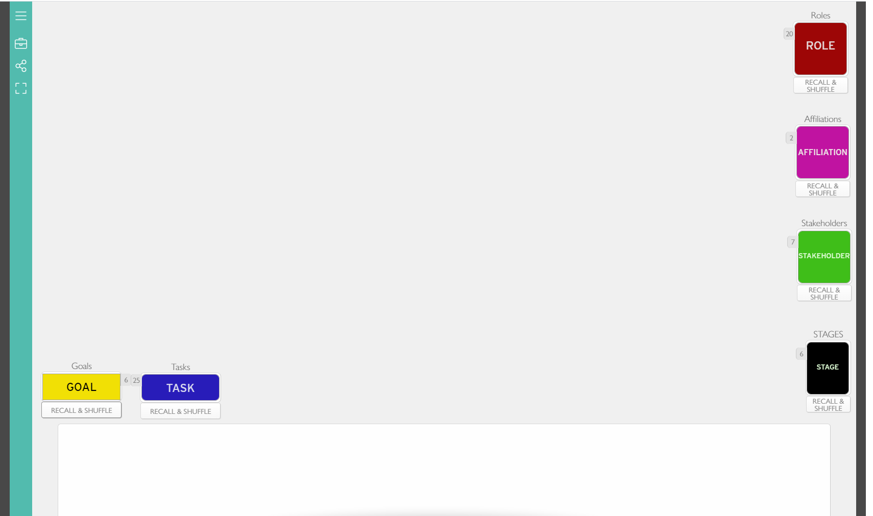
EXERCISES – STARTING TABLE LAYOUT
Notes:
BREAK OUT ROOM [MENTOR]
STEP 1 TIMING: 15 mins
Talk the group through the mechanics of the play
How to move cards etc
Wait your turn etc.
This is what the table should look like before you start the exercises. The following layouts are only for guidance as the exact layout at the end of each exercise will be different depending on the cards selected by each team.
To reset the table to this state you should click the “Recall & Shuffle” buttons below each deck of cards.
NOTE: Clicking RECALL is not UNDOABLE. You will have to move all the cards back manually. Have your team do this a few times so they understand what will happen!

Slide 7
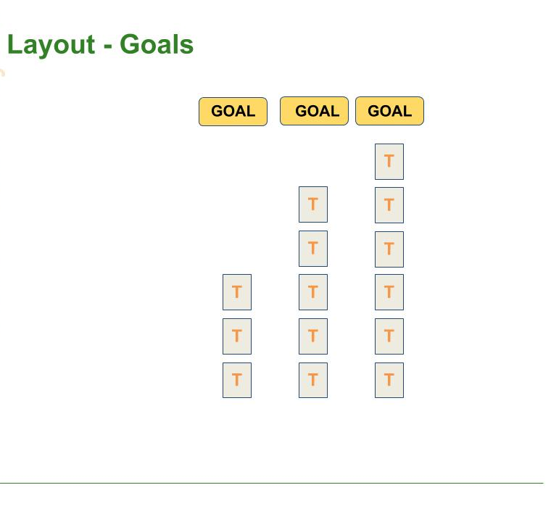
GOALS TO TASKS
ORDER OF PLAY
Select the GOALS that match the proposal in Use Case 1 then identify any TASKS required to accomplish those goals.
In the breakout room
Do STEP 1
Come back to the main room when called
mentor screen-shares
one team member presents. Explain one goal and why it was chosen. List if any goals were missing.
Notes:
BREAK OUT ROOM [START EXERCISE]
STEP 1 TIMING: 15 mins
STEP 1) GOALS to TASKS
- Teams should select the GOALS those of the proposal in Use Case 1, then identify any TASKS required to accomplish those goals.
Order of play:
In the breakout room
-- Together do exercise 1
-- [MENTOR] deals cards into separate piles on the table for each team member. Team member takes the cards into their hand.
-- Each member puts all their cards on the table, GOALS to keep go on the right, GOALS not needed go to the left, so that everyone can see the cards
-- Pick a reporter one team member presents to explain why ONE goal was chosen and the tasks that were put to that goal
-- [MENTOR] takes the discards into their hand
-- Return to Main Group to report out.
-- [MENTOR] screen-shares
-- [MAHEVA] take a screenshot of each teams table
[BACK TO MAIN ROOM]

Slide 8
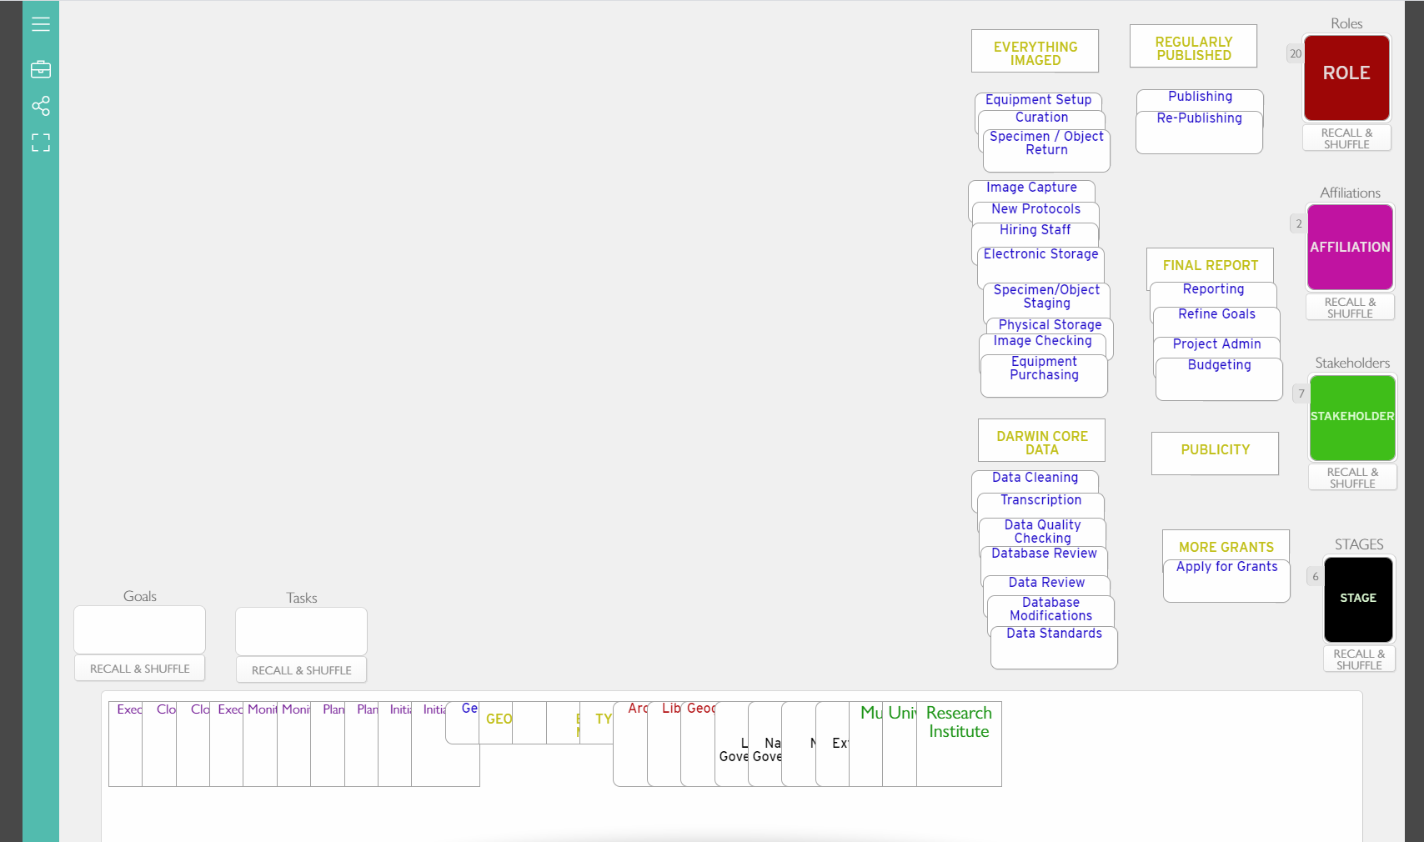
STEP 1 - TABLE SETUP
Notes:
BREAK OUT ROOM [END EXERCISE]
STEP 1 TIMING: 15 mins
This is approximately the layout after exercise 1.
As the [MENTOR] you should remove any cards not used by the team into the area at the bottom of your screen.
This will take them off the table and make space. The rest of the team can no longer see these cards but you may put them back into play at any time.
HINT: Once you have cards in your hand at the bottom of the table, clicking the Recall buttons once will only tidy up the cards in play on the open table. If you see “RECALL ALL” do NOT click it as that will take all the cards back and you will have to start from scratch!

Slide 9
GROUP REVIEW - GOALS to TASKS
GOALS to TASKS
Tell us about A GOAL you chose and the tasks you put to that goal.
Notes:
WHOLE GROUP TOGETHER [TRAINER]
REVIEW TIMING: 10 mins for whole Group Discussion
Not enough time for each group to describe each goal/tasks, so just describe one goal.
Team [red] Report back please:
Team [blue] Report back please:
Team [green] Report back please:
Team [yellow] Report back please:
Team [purple] Report back please:
[TRAINER] If time allows, ask a question to the whole group...Were there any tasks or goals that weren’t described in the scenario that you would recommend to the project team in that scenario

Slide 10
EXERCISES
GOALS to TASKS
STAKEHOLDERS to AFFILIATIONS
ROLES to STAKEHOLDERS
TASKS to ROLES
STAGES
A
B
Notes:
WHOLE GROUP TOGETHER [TRAINER]
STEPS 2&3 TIMING: 25 mins to Complete task
2) ROLES to STAKEHOLDERS
Assigning ROLES to their STAKEHOLDER groups
3) STAKEHOLDERS to AFFILIATIONS
and identifying the STAKEHOLDER AFFILIATIONS
[GO TO BREAKOUT ROOM]

Slide 11
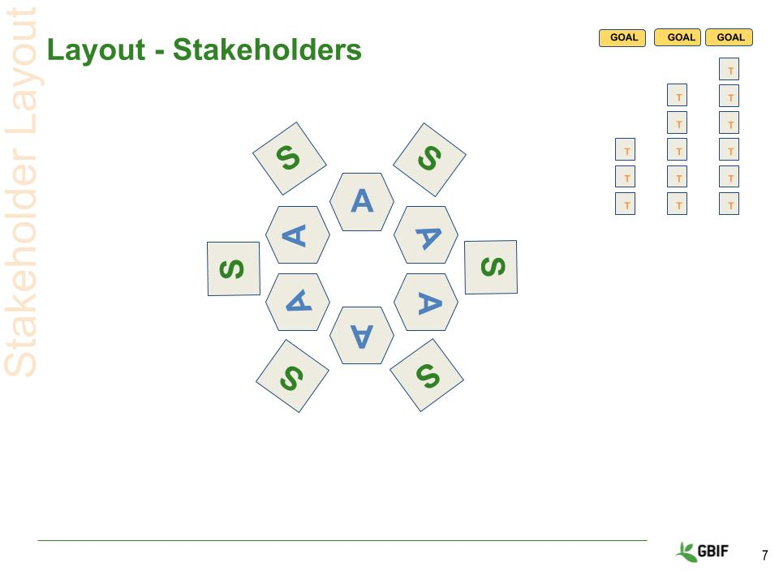
STAKEHOLDERS TO AFFILIATIONS
ORDER OF PLAY
Assign the STAKEHOLDER groups to the AFFILIATION that best matches the scenario in Use Case 1.
In the breakout room
Do STEP 2
Then continue to STEP 3
Notes:
BREAK OUT ROOM [MENTOR]
STEPS 2&3 TIMING: 25 mins to Complete task
STEP 2) STAKEHOLDERS to AFFILIATIONS
assign STAKEHOLDERS to the AFFILIATIONS that best match the scenario in Use Case 1.
Order of play:
Go to breakout room
------ [MENTOR] Place the AFFILIATION cards in the middle of the table face up and let the TEAM decide which ones they want to use according to the use case scenario.
------ [MENTOR] Place the STAKEHOLDER cards on the table face up and let the TEAM decided which ones to use and then assign them to the appropriate AFFILIATION
------ [MENTOR] You might need to move things around a bit to fit them
-- [MENTOR] takes the discards into their hand

Slide 12
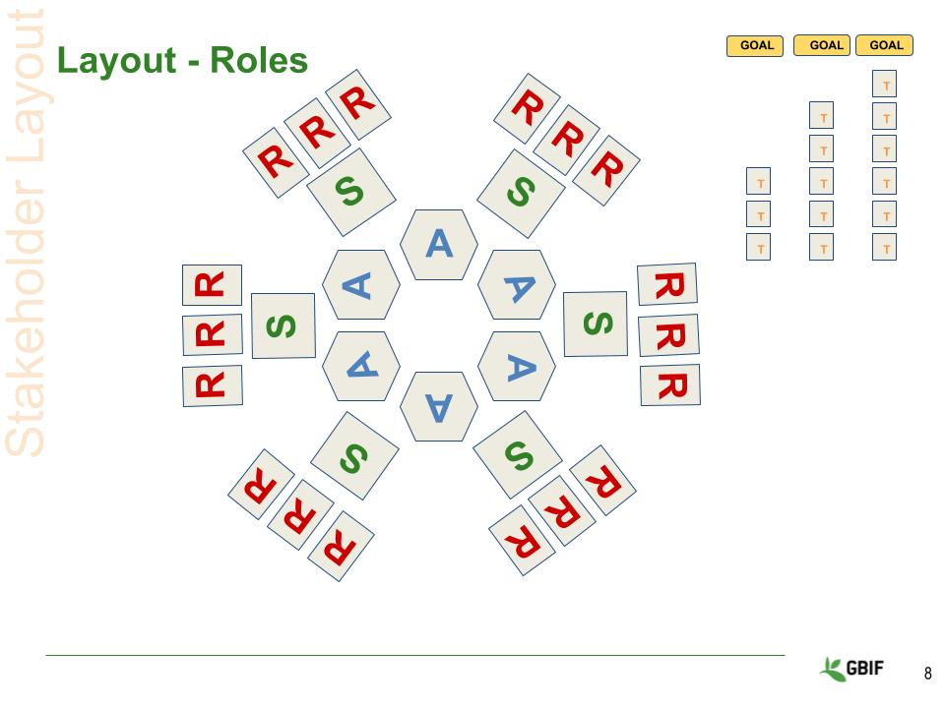
ROLES TO STAKEHOLDERS
ORDER OF PLAY
Based the scenario in Use Case 1 select available ROLES from and assign them to STAKEHOLDER groups.
In the breakout room
Do STEP 3
Come back to the main room
a different team member presents to explain one interesting stakeholder assignment from their table.
mentor screen-shares.
Notes:
BREAK OUT ROOM [MENTOR]
TASKS 2&3 TIMING: 25 mins to Complete task
STEP 3) ROLES to AFFILIATIONS
- Using the ROLES identified from the use case, the team should assign them to their STAKEHOLDER.
Order of play:
In the breakout room
-- Together do STEP 3
------ [MENTOR] Divide up the ROLE cards between the team members.
------ Each member puts all their cards on the table, placing the ROLE cards on top of the STAKEHOLDER cards. You will likely need to arrange and overlapping the cards.
-- [MENTOR] takes the discards into their hand
-- [MENTOR]: Select a new Reporter
-- [REPORTER] one different team member presents to the whole GROUP to discuss one of their role(s)->stakeholder->affiliation assignments for the project in use case 1.
-- Return to Main Group to report out.
-- [MENTOR] screen-shares
-- [MAHEVA] take a screenshot of each teams table
[BACK TO MAIN ROOM]

Slide 13
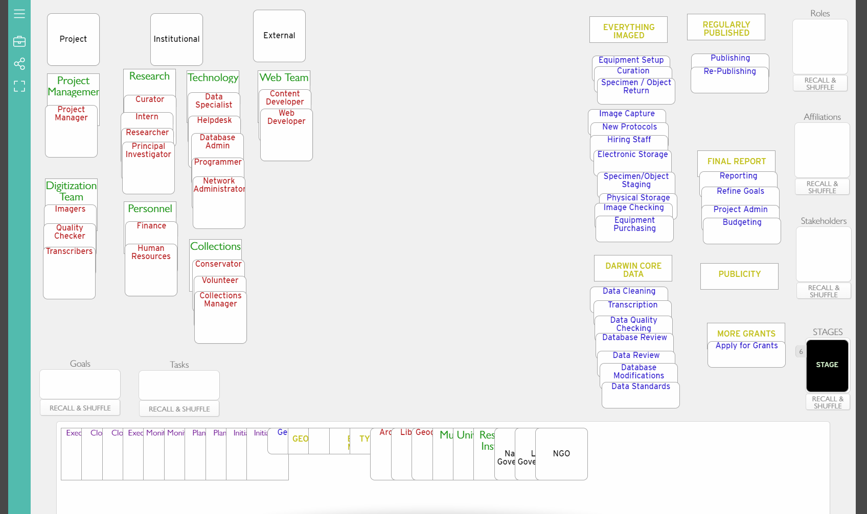
STEPS 2&3 - TABLE SETUP
Notes:
BREAK OUT ROOM [MENTOR]
STEPS 2&3 TIMING: 25 mins to Complete task
This is approximate layout at the end of step 3.
As the [MENTOR] you should remove any cards not used by the team into the area at the bottom of your screen.
This will take them off the table and make space. The rest of the team can no longer see these cards but you may put them back into play at any time.
HINT: The table is now filling up so you will probably need to take charge of moving the cards around to make sure that everything fits. If you need to recall a set of cards you can just NEVER click “RESET ALL”.
You can also place cards directly on top of one another and a little tab will show up telling you how many cards are piled up. You can drag this tab and all the cards will move at the same time.

Slide 14
GROUP REVIEW - AFFILIATIONS, STAKEHOLDERS and ROLES
STAKEHOLDERS to AFFILIATIONS
ROLES to STAKEHOLDERS
Tell us about ONE of your role(s) → stakeholders → affiliation assignments
Notes:
WHOLE GROUP TOGETHER [TRAINER]
TASKS 2&3 TIMING: 10 mins Whole Group Discussion
[REPORTER] discuss one of their role(s)->stakeholder->affiliation assignments for the project in use case 1.
Team [Blue] Report back please:
Team [Green] Report back please:
Team [Yellow] Report back please:
Team [Purple] Report back please:
Team [Red] Report back please:
[TRAINER] if time allows ask the group a question...Are there resources (people) missing from the cards that you feel are critical to the successful completion of the project in this scenario?

Slide 15
EXERCISES
GOALS to TASKS
STAKEHOLDERS to AFFILIATIONS
ROLES to STAKEHOLDERS
TASKS to ROLES
STAGES
A
B
Notes:
WHOLE GROUP TOGETHER [TRAINER]
STEP 4 TIMING: 15 mins To Complete Task
[THE NEXT EXERCISE WILL BE]
STEP 4) TASKS to ROLES
Deciding which ROLES will carry out which TASKS
[GO TO BREAKOUT ROOM]

Slide 16
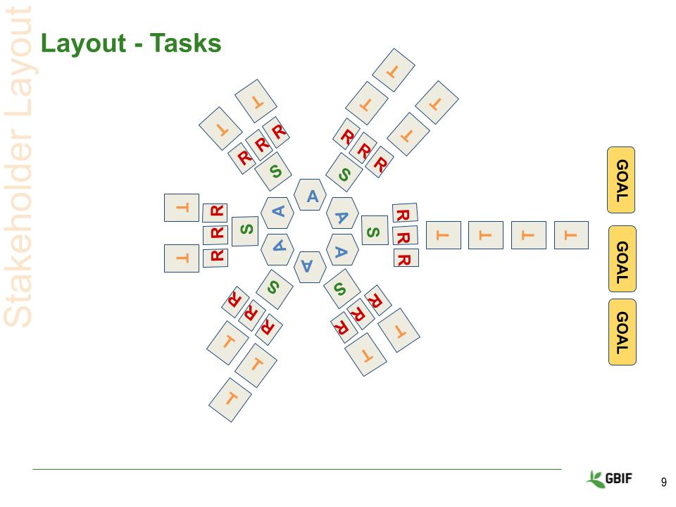
TASKS TO ROLES
ORDER OF PLAY
Decide which ROLES will complete the TASKS identified in STEP 1
In the breakout room
Do STEP 4
Come back to the main room
one team member presents. Explain either one bottleneck (too many tasks) or gap (no role for a task) and any new roles.
mentor screen-shares.
trainer take a screenshot of each teams table
Notes:
BREAK OUT ROOM [LEADER]
TASK 4 TIMING: 15 mins To Complete Task
Exercise 4) TASKS to ROLES
- The team should now decide which tasks should be assigned to a particular role.
Order of play:
In the breakout room:
-- Together do STEP 4
-- [MENTOR] -- RECALL the AFFILIATION and STAKEHOLDER cards if you need more room on the TABLE.
-- [MENTOR -- Redistribute the TASK cards (moving them from their GOALS) and have the TEAM assign them to appropriate ROLES (i.e. who will complete the TASK)
-- [REPORTER] -- a different team member presents to explain either one bottleneck (too many tasks) or gap (no role for a task or roles without tasks).
-- [MENTOR] takes the discards into their hand
-- Return to Main Group to report out.
-- [MENTOR] screen-shares
-- [MAHEVA] take a screenshot of each teams table
[BACK TO MAIN ROOM]

Slide 17
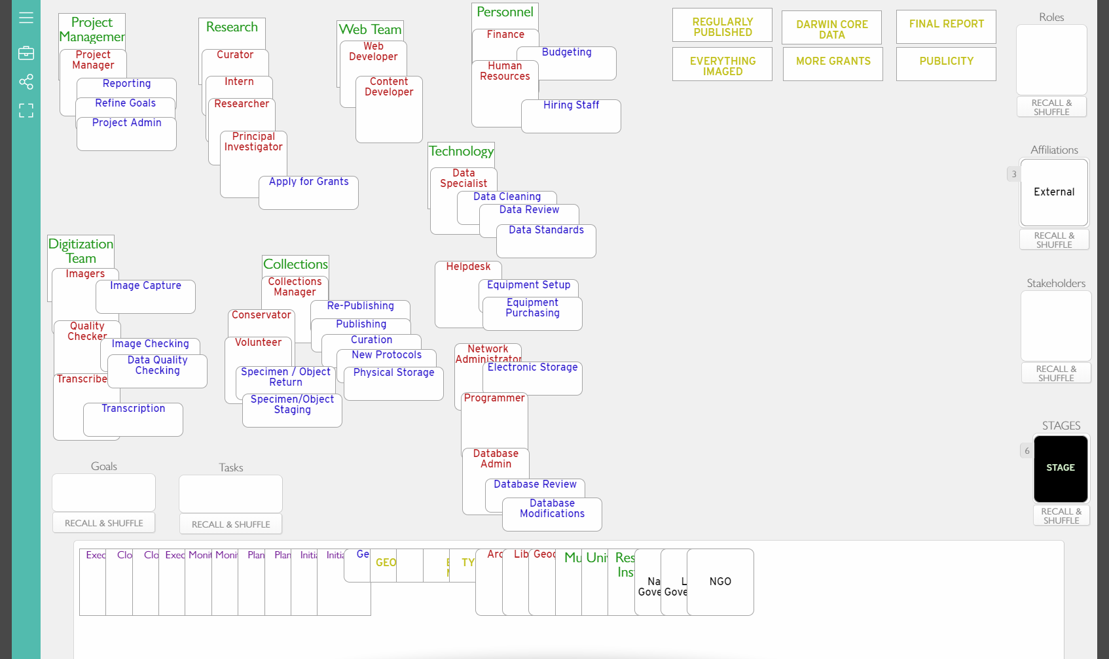
STEP 4 - TABLE SETUP
Notes:
BREAK OUT ROOM [MENTOR]
STEP 4 TIMING: 15 mins To Complete Task
This is approximate layout at the end of STEP 4.
As the [MENTOR] you should remove any cards not used by the team into the area at the bottom of your screen.
This will take them off the table and make space. The rest of the team can no longer see these cards but you may put them back into play at any time.
HINT: The table is now filling up so you will probably need to take charge of moving the cards around to make sure that everything fits. If you need to recall a set of cards you can just NEVER click “RESET ALL”.
You can also place cards directly on top of one another and a little tab will show up telling you how many cards are piled up. You can drag this tab and all the cards will move at the same time.

Slide 18
GROUP REVIEW - TASKS TO ROLES
TASKS to ROLES
Tell us about ONE bottleneck or gap you identified.
Notes:
WHOLE GROUP TOGETHER [TRAINER]
TASKS 4 TIMING: 10 mins Whole Group Discussion
Team [Green] Report back please:
Team [Yellow] Report back please:
Team [Purple] Report back please:
Team [Red] Report back please:
Team [Blue] Report back please:
[TRAINER] if time allows ask the group a question...Does anyone have an example in their own work where they can now see that they were experiencing a gap or a bottleneck?

Slide 19
REVIEW - ORGANISING
Successful implementation is dependant on the development of realistic, efficient and streamlined processes and.
Stage Cards
describe the different “When” it will happen during your project.
Groupings
are ways to divide a project into manageable stages based on specific criteria. Task Clusters
describe the most common natural history set of digitization tasks.
Workflows
allow you to connect tasks and task clusters into logical sequences.
Notes:
WHOLE GROUP TOGETHER [TRAINER]
Reviewing, the session on ORGANIZING
we looked at ways to arrange the elements together into feasible workflows,
Groupings - are ways to divide a project into manageable stages based on specific criteria, for example time. They help you to assign milestones and mark progress.
Task Clusters - these describe the most common natural history set of digitization tasks.
Workflows - these allow you to connect tasks and task clusters into logical sequences with criteria and logic to describe actualities of day-2-day project working.

Slide 20
EXERCISES
GOALS to TASKS
STAKEHOLDERS to AFFILIATIONS
ROLES to STAKEHOLDERS
TASKS to ROLES
STAGES
A
B
Notes:
[THE NEXT EXERCISE WILL BE]
STEP 5 TIMING: 20 mins To Complete Task
5) STAGES
Arrange the tasks in a sensible order for implementation.
[GO TO BREAKOUT ROOM]

Slide 21
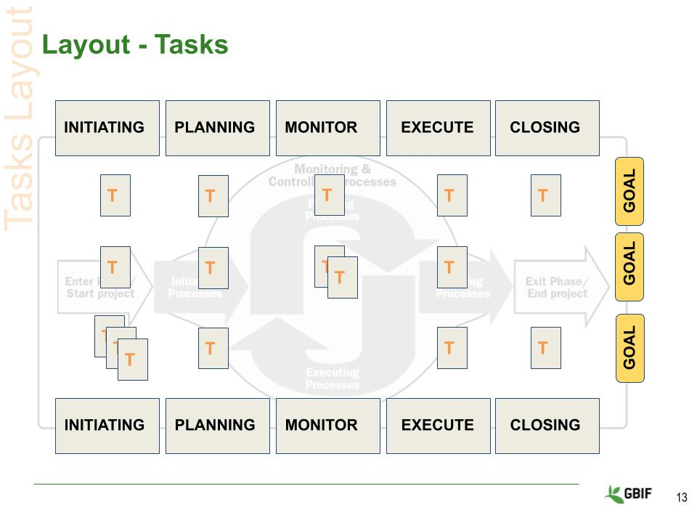
STAGES
ORDER OF PLAY
Choose either the simple stages or the PMBoK stages , to arrange the tasks into chronological order.
In the breakout room
Do STEP 5
Come back to the main room
one team member presents, explaining if the team found anything difficult or interesting. For example could you foresee any scheduling conflicts for a particular role.
mentor screen-shares.
Notes:
BREAK OUT ROOM [MENTOR]
STEP 5 TIMING: 20 mins To Complete Task
STEP 5) - Arrange the tasks in a sensible order for implementation.
Order of play:
-- [MENTOR] On your table
-- RECALL the STAKEHOLDER and AFFILIATION cards on their stack by clicking recall and clicking to flip the stack face up if you haven’t already
-- Remove any ROLE card that does not have a TASK assigned to it to their stack.
-- Put the STAGE cards in your hand.
-- [MENTOR] Explain the STAGE cards to the team (simple v PMBoK). Choose which set to use.
-- [MENTOR] takes the discards into their hand
-- [TEAM] move ROLES/TASKS into chronological order.
-- [REPORTER] a different team member presents explaining if the team found anything difficult or interesting. For example could you foresee any scheduling conflicts for a particular role
-- Return to Main Group to report out.
-- [MENTOR] screen-shares
-- [MAHEVA] take a screenshot of each teams table
[BACK TO MAIN ROOM]

Slide 22
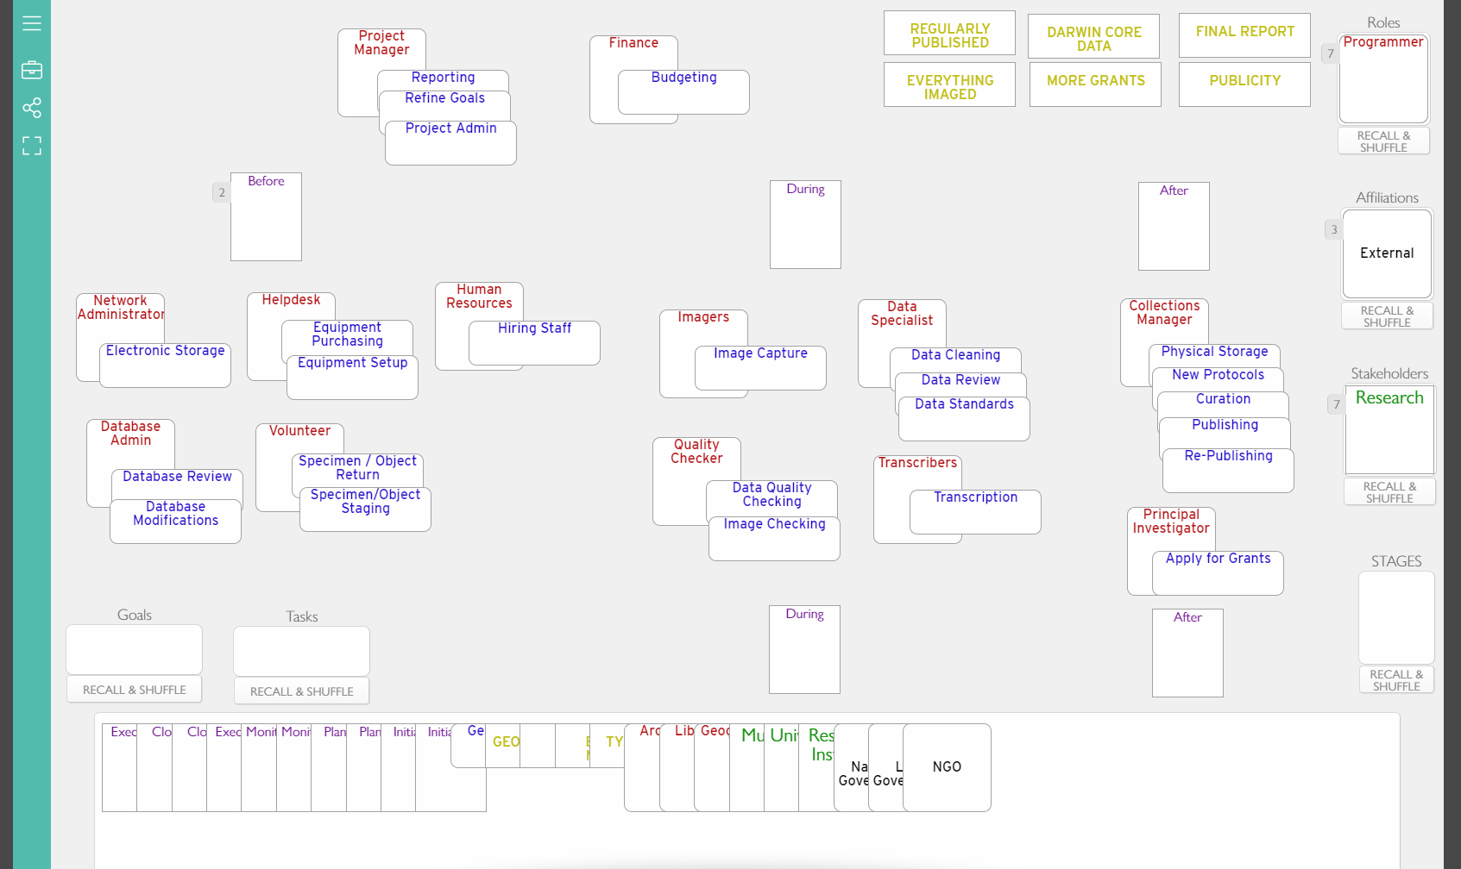
STEP 5 - TABLE SETUP
Notes:
BREAK OUT ROOM [MENTOR]
TASK 5 TIMING: 20 mins To Complete Task
This is approximate layout at the end of exercise 5.
As the [MENTOR] you should remove any cards not used by the team into the area at the bottom of your screen.
This will take them off the table and make space. The rest of the team can no longer see these cards but you may put them back into play at any time.
HINT: You may find that the group really wants to expand on the stages that they have to describe the workflow. If this is the case and you have time you can return the PMBoK cards to the table and they can use those in place of or as well as the simple cards.

Slide 23
GROUP REVIEW - STAGES
STAGES
Tell us about anything difficult or interesting you found when placing tasks in chronological order. Any scheduling conflicts?
Notes:
WHOLE GROUP TOGETHER [TRAINER]
TASKS 2&3 TIMING: 10 mins Whole Group Discussion
Team [Yellow] Report back please:
Team [Purple] Report back please:
Team [Red] Report back please:
Team [Blue] Report back please:
Team [Green] Report back please:
[TRAINER] if time allows ask the group a question…
What similarities and differences can be seen in the flows?
Were there common issues that came up across the groups?

Slide 24
MOVING FROM PROJECT PROPOSAL TO IMPLEMENTATION PLAN
GOALS to TASKS
STAKEHOLDERS to AFFILIATIONS
ROLES to STAKEHOLDERS
TASKS to ROLES
TASKS to STAGES
Notes:
WHOLE GROUP TOGETHER [TRAINER]
These exercises are just one way to help you organize your thoughts around turning a theoretical project proposal into a working implementation plan. Whichever method you use it is vitally important to assess your resources as quickly as possible and before starting the work of digitization and mobilization.
Remember that no plan is perfect, and it is normal for them to be reworked, tweaked and refined as a project proceeds, they should be dynamic.
Of course such dynamism can also be accounted for and included as part of the plan. Deliberately building in flexibility is the key to successful implementation.

